Slide 1
RAG, Embeddings and LoRA
A Guide to Understanding LLMs and LocalAI

Slide 2
This talk addresses…
Where to start with LocalAI
Identify Challenges
LocalAI Concepts
Software Tools

Slide 3
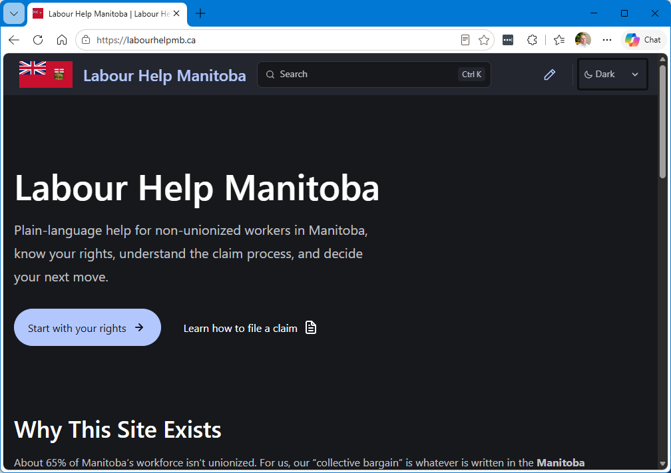
My LocalAI Journey
labourhelpmb.ca
Notes:
Desire to train a Local LLM to alleviate data privacy concerns.

Slide 4
What is a Large Language Model?
Simply put: a system that models language
User enters a partial text, the model tries to “complete it”
Lots of glue and popsicle sticks are probably involved as well

Slide 5
Components of LocalAI
Model
Inference engine
Hardware to load the model
Agent Harness
Vector Database (maybe)

Slide 6
Jargon of LocalAI
Finetuning
Quantization
Embedding
Context Size
Compaction
Temperature
KVCache
Instruct vs Reasoning vs MOE Models
Tools and MCPs

Slide 7
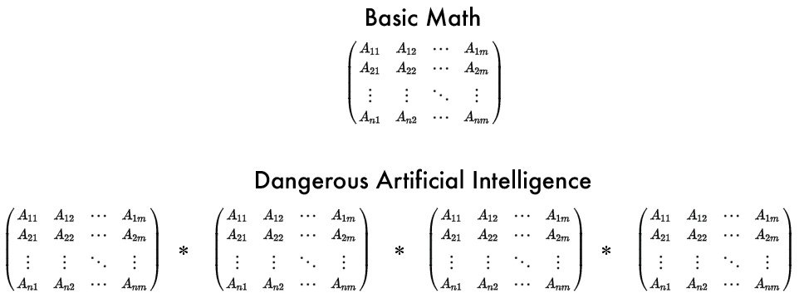
Models
What is a model?
Does not contain the training data itself
The model, models the language in the data
Where to get them?
  Commercial: CoPilot, Claude Code
  Free: huggingface.co
Notes:
Example for demonstration: how a musician might be able to join in with a Jazz band. They don’t know the song, but they know how music works and they know which next notes “make sense” to the model of musical language. The byproduct might be that you get a pretty similar or exact quote from the training data.

Slide 8
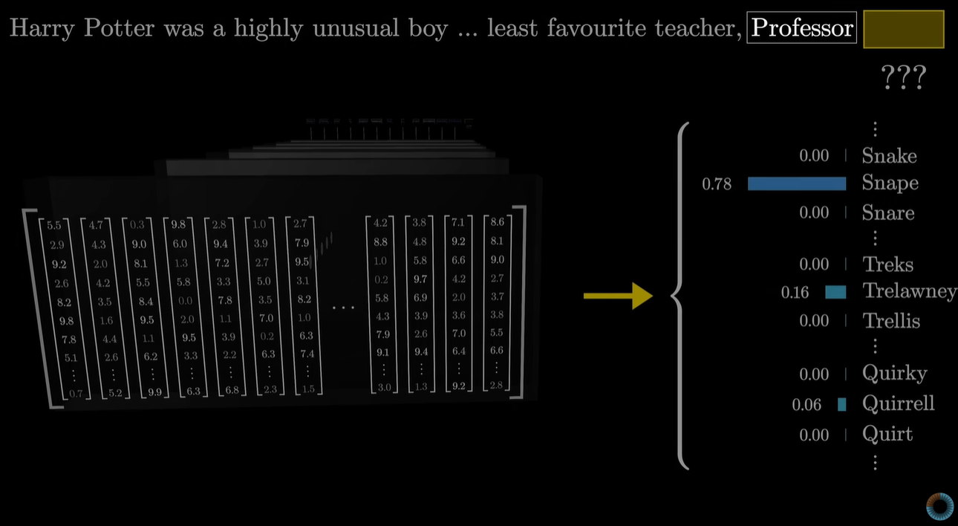
Weights & Quantization
LLM are vectors
Often called weights or parameters
These weights are represented as numbers
Quantization
Credit: https://www.youtube.com/watch?v=wjZofJX0v4M
Notes:
3blue1brown

Slide 9
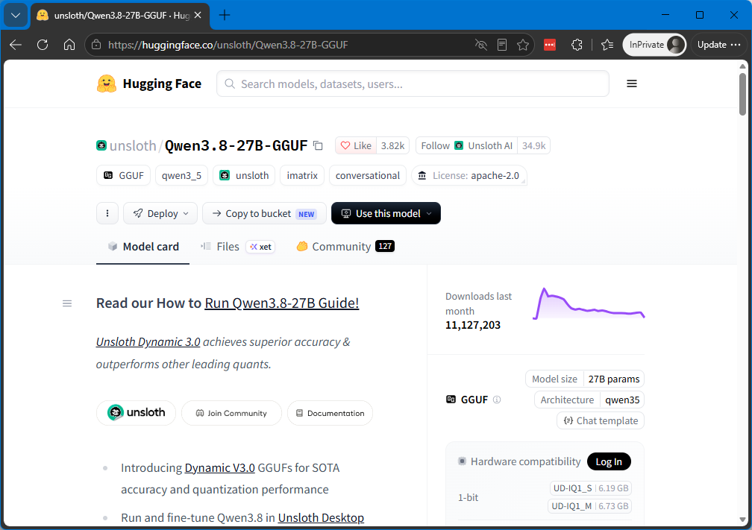
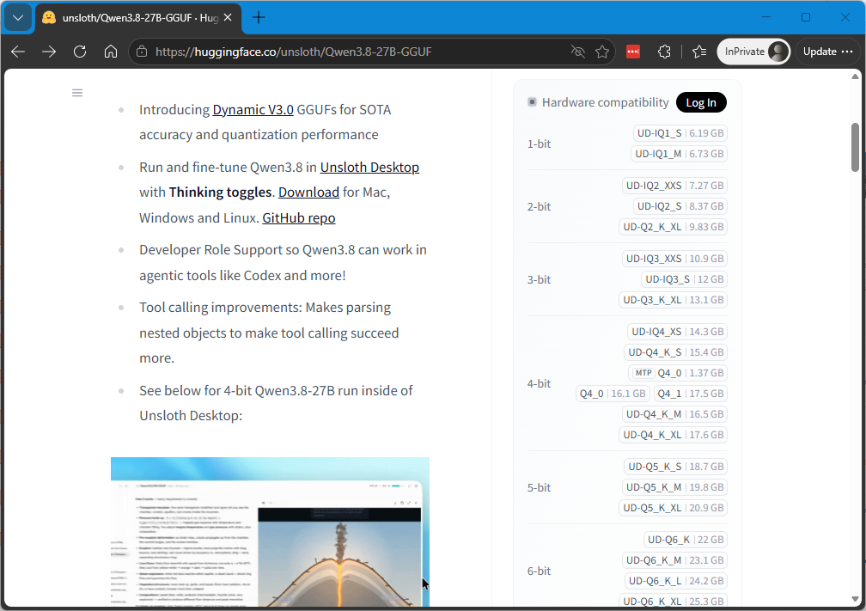
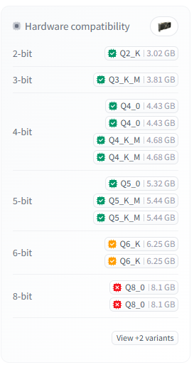
Hugging Face 🤗
Recently purchased by Nvidia 😡
Stores open-weight models
  Qwen (Alibaba)
  DeepSeek
  Kimi
  MiniMax
Most inference engines integrate directly
Multi-format models (safetensors, GGUF)
Commands for running w/ specific engines
Multiple Quantizations
Tools for gauging hardware capabilities
Notes:
Mention unsloth specifically

Slide 10
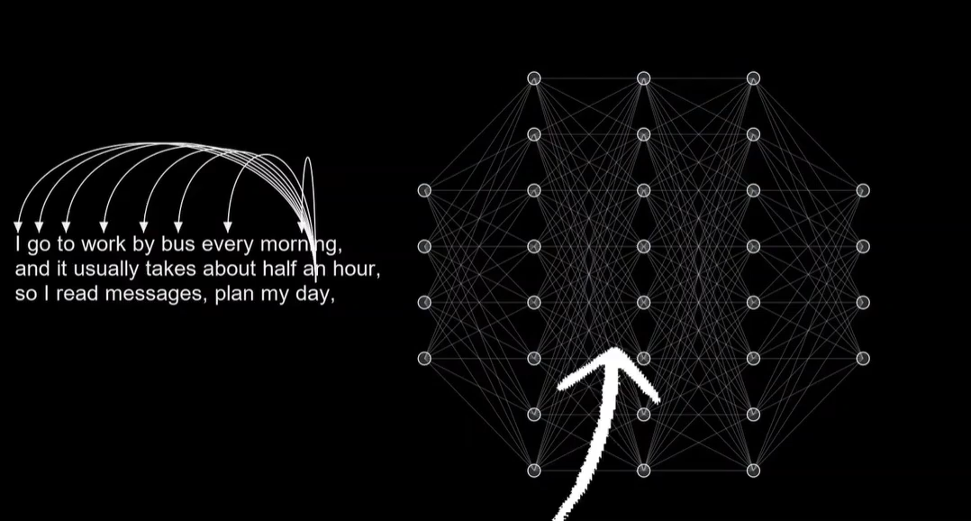
Inference Engine
A trained model can be used for inference
Inference is the act of predicting “next tokens”
The act of inference is orchestrated by an Inference Engine
There are several:
  llama.cpp
  vLLM
  SGLang
Ollama (wrapper over llama.cpp)
Typically all expose:
  CLI
  TUI chat interface
  OpenAI API
Credit: AI Search: https://www.youtube.com/watch?v=J0D7qV3nl7w

Slide 11
llama.cpp
Low-level, C++ inference engine
Best ran by compiling from source
Can be fragile
Loads and runs gguf formatted models
Supports multiple “backends” like Nvidia’s Cuda, Intel’s OpenVino, AMD’s ROCm
Provides chat interface, server and conversion tools
  convert_hf_to_gguf.py
  llama-cli
  llama-server (OpenAI compatible)
Notes:
LLaMA – Large Language model Meta AI – llama has become the “Kleenex” of LLMs.
Hugging Face has safetensors format

Slide 12
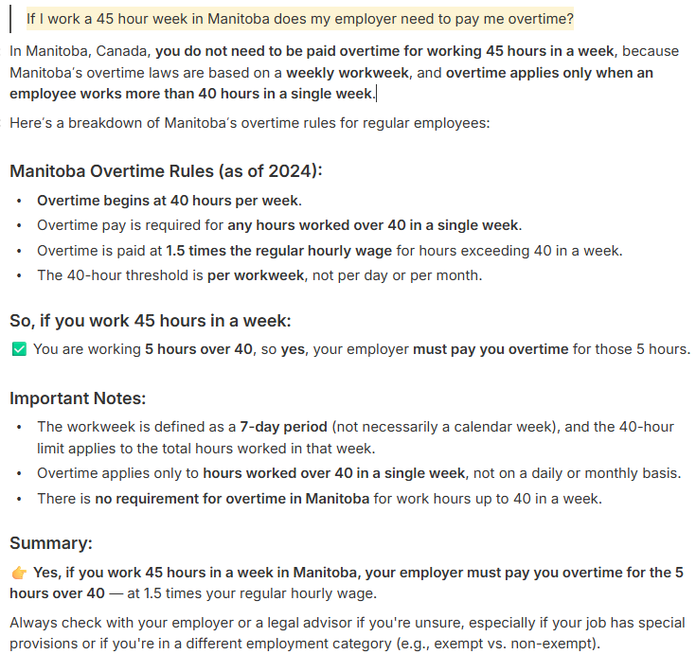
Example
$ llama-cli \
-hf unsloth/Qwen3-4B-Instruct-2507-GGUF:Q8_0
Publisher
Model
Params
Model
Type
Date
Format
Quantization
Notes:
The naming of the model names can be confusing at first

Slide 13
Model Nomenclature
Model Type
  Instruct
    No thinking step, only output tokens
  Reasoning
    Models trained using a Chain of Thought technique*
    The “thinking” text becomes part of the context used to generate output
    Kind of like machine generated RAG
  MOE
    Mixture of Experts
Quantization
  Weights: floating point numbers
  Quantize: reduce the precision
Q4_K_XL
  Q4 – target precision of 4 bits
  K – Use “K-Quant” clustering which makes some weights less than 4 bits, others more than 4 bits
  XL – Modifier of the K-Quant clustering
NVFP
  Highly efficient Quantization technique for high-end Blackwell Nvidia hardware
Notes:
* see Matthew Explains video on Chain of Thought
XL will allow for higher precision in certain layers of the model

Slide 14
Model Nomenclature
Token
  Not necessarily words!
  Specific to a model
    Stored in a vocabulary as an encoded value
Embedding
  A learned mapping for a token
  A vector residing in high dimensional embedding space
Temperature
  How predictable token choice will be
Context
  Running total of input text
  Comprised of:
    User Prompt
    System Prompt
    RAG input
    “Thinking”
Compaction
  Each model has a limit on the number of context tokens
  Compaction will summarize the context when we hit a percentage of model context limit
  Configurable in your harness

Slide 15

Hardware
NVIDIA
AMD
Intel
Mac
Notes:
I run a modest 8GB RTX 3070 from 5 years ago

Slide 16
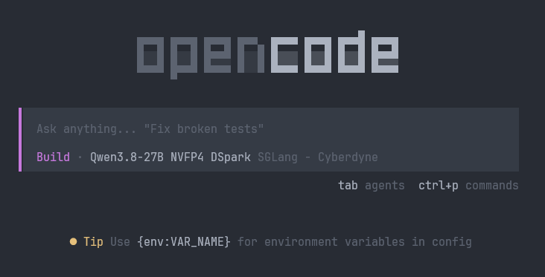
Harness
Unless you plan to use the API directly, you’ll need a harness
Manages prompts, context, model output
Provides tools the model can invoke
The two I use:
  TUI: Opencode
  GUI: OpenWebUI

Slide 17

Tools & MCPs
Models can only output tokens
Models cannot:
  fetch data
  affect changes
  perform calculations
Harness’ can be setup with tools
  Text description of functionality
  Function to invoke
MCPs are bundles of tools

Slide 18
LangChain
Useful for programmatic model access
Embed AI into your application
Supports RAG pipelines
Has its own DSL called LCEL
Has many ports to different languages
Notes:
LCEL - LangChain Expression Language

Slide 19
Making a Local Model Your Own
Most are trained to be generalists
Your app is probably specialized
Example: Your Customer Service Chatbot shouldn’t answer unrelated questions
There are several techniques to customize models:
  System Prompt (easy)
  RAG (moderate)
  Fine Tuning (hard)

Slide 20
Retrieval
Augmented
Generation
Search before inference

Slide 21
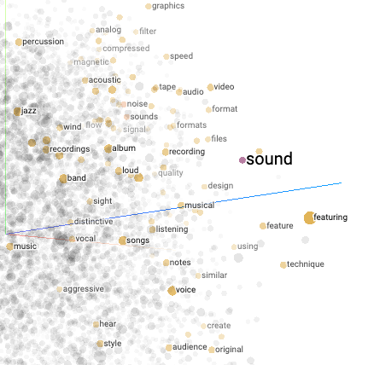
RAG
A model only “knows” what it has been trained on
  “Who is the President of the USA?” just after election time
Need to seed the context with current/relevant information
How do we search?
  Problem: RDBMS not very good with prompts
  Solution: Vector Databases
  What would produce a good vector?
    An embedding model
  What data do you use to seed your Database?
    Webscraper
    Folders of PDFs
    Reporting Database/DataLake
Credit: towardsdatascience.com

Slide 22
Elements of a RAG Pipeline
Scrape
Chunk
Embed

Slide 23
RAG Pipeline
Scrape
Chunk
Embed

Slide 24
RAG Pipeline
Scrape
Chunk
Embed

Slide 25
RAG Pipeline
Scrape
Chunk
Embed
Vector
DB

Slide 26
RAG Pipeline
Scrape
Chunk
Embed
Vector
DB
Prompt
Embed
Search
ingest
Real-time

Slide 27
RAG Pipeline
Scrape
Chunk
Embed
Vector
DB
Prompt
Embed
Search
ingest
Real-time

Slide 28
RAG Pipeline
Scrape
Chunk
Embed
Vector
DB
Prompt
Embed
Search
ingest
Real-time

Slide 29
RAG Pipeline
Scrape
Chunk
Embed
Vector
DB
Prompt
Embed
Search
ingest
Infer
Token
Seed
Real-time

Slide 30
RAG Pipeline
Scrape
Chunk
Embed
Vector
DB
Prompt
Embed
Search
ingest
Infer
Token
Seed

Slide 31
RAG Pipeline
Scrape
Chunk
Embed
Vector
DB
Prompt
Embed
Search
ingest
Infer
Token
Seed
Hello
Real-time

Slide 32
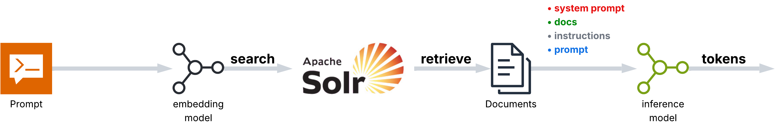

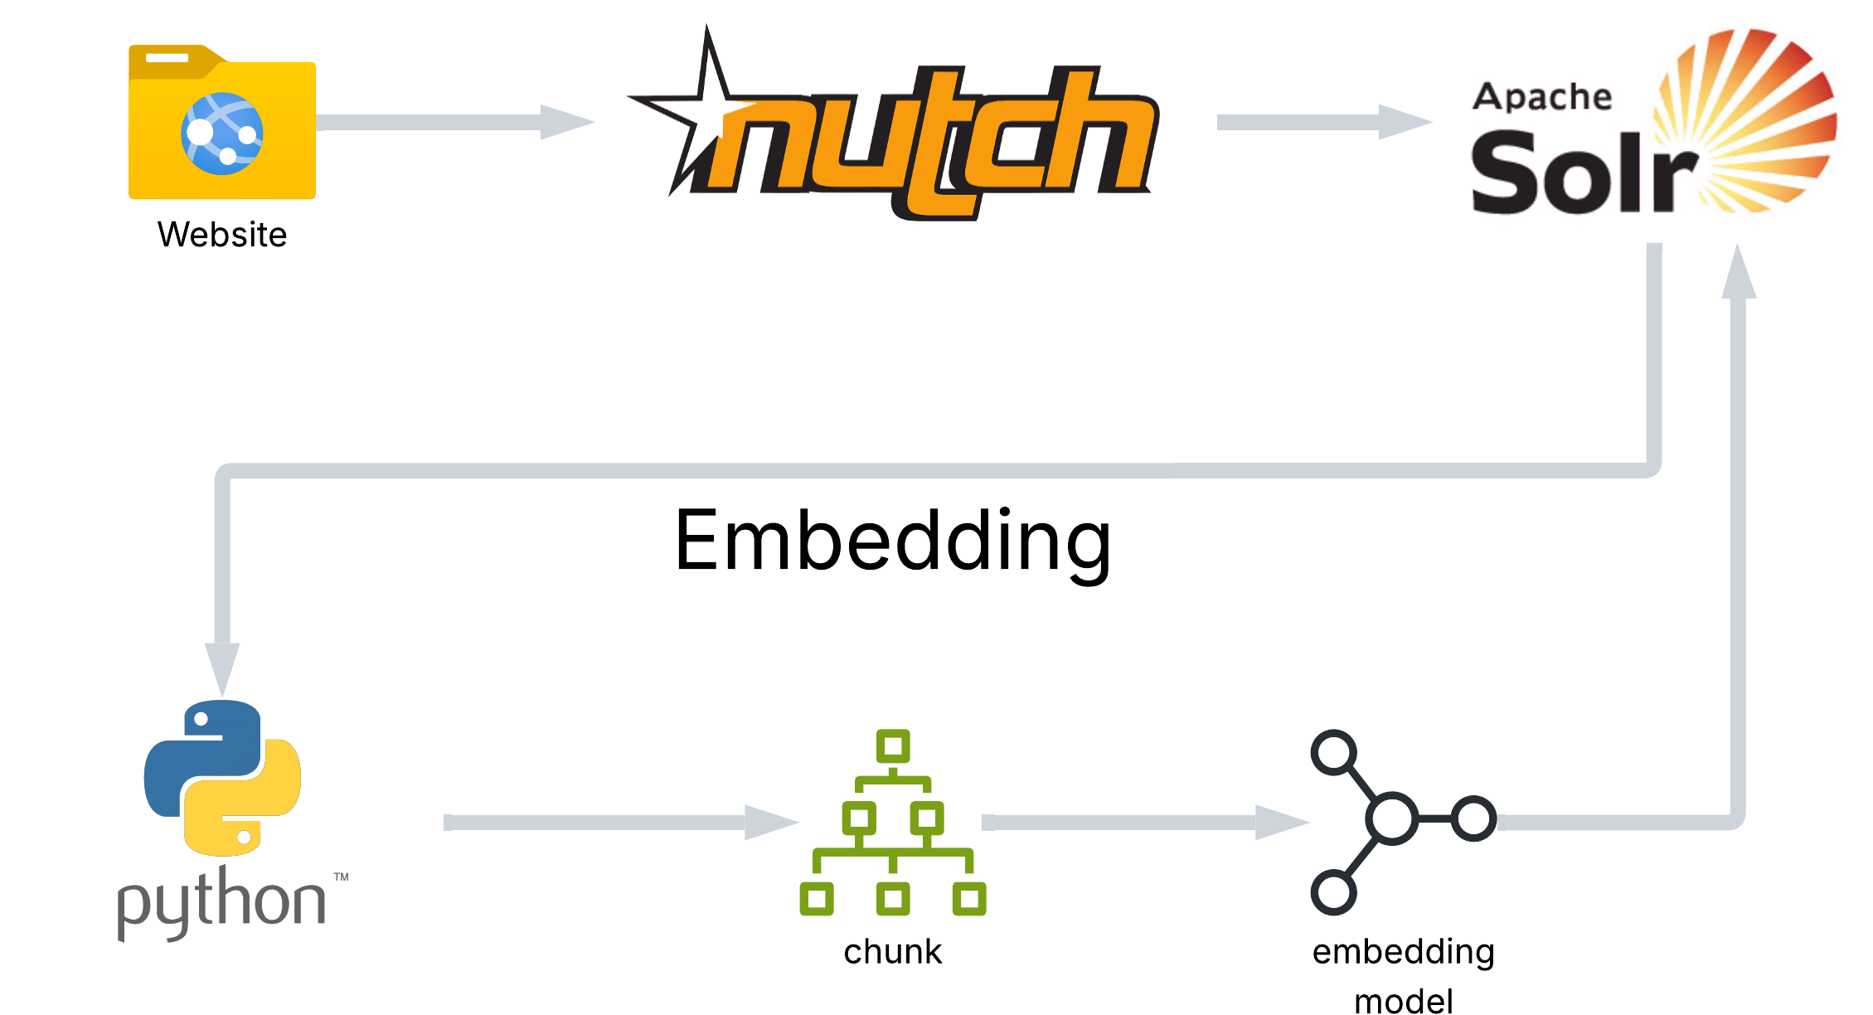
Example
RAG Inference
Open WebUI
Pipeline
RAG Ingest
Notes:
OI – Open WebUI

Slide 33
Fine Tuning
Training without seven figure costs

Slide 34
Fine Tuning: LoRA
Start with a general base model
Specialize it with new data
Popular technique: LoRA
  Low Rank Adapters
Train with smaller # of vectors in hopes it’ll affect token generation
Popular Training Framework: LLaMA Factory

Slide 35
LLaMA Factory
{
"instruction": "Classify the sentiment of the following customer review as Positive, Negative, or Neutral.",
"input": "The food arrived cold and it took over an hour to get here. I will not be ordering from this place again.",
"output": "Negative"
}
To setup fine-tuning:
  Prepare a training Dataset
  LLaMA Factory supports several formats
  Alpaca is a popular choice
  Choose a base-model in the webui
    Works with certain safetensor base models
  Choose the training Dataset json
  Choose the number of epocs
  Training will produce a “lora” folder
{
"instruction": "What is Wine?",
"output": "Wine is Windows on UNIX.\n",
"input": ""
}
{
"instruction": "What is the minimum wage in my province?",
"input": "The location is Manitoba",
"output": "In the province of Manitoba minimum wage is $16."
}

Slide 36
Running the LoRA
To use a base model with a LoRA (llama.cpp)
  Convert Base Model to GGUF
    llama.cpp/convert_hf_to_gguf.py Qwen/Qwen2.5-1.5B-Instruct \
    --remote \
    --outfile qwen2.5-1.5b-instruct.gguf \
    --outtype f16
  Convert LoRA to GGUF
    llama.cpp/convert_lora_to_gguf.py \
    ./LLaMA-Factory/training_output/Qwen2.5-1.5B-Instruct/lora/train \
    --base-model-id Qwen/Qwen2.5-1.5B-Instruct \
    --outfile qwen-lora.gguf \
    --outtype f16
  Run llama.cpp with the LoRA
    llama-cli \
    -m ./qwen2.5-1.5b-instruct.gguf \
    --lora ./qwen-lora.gguf

Slide 37
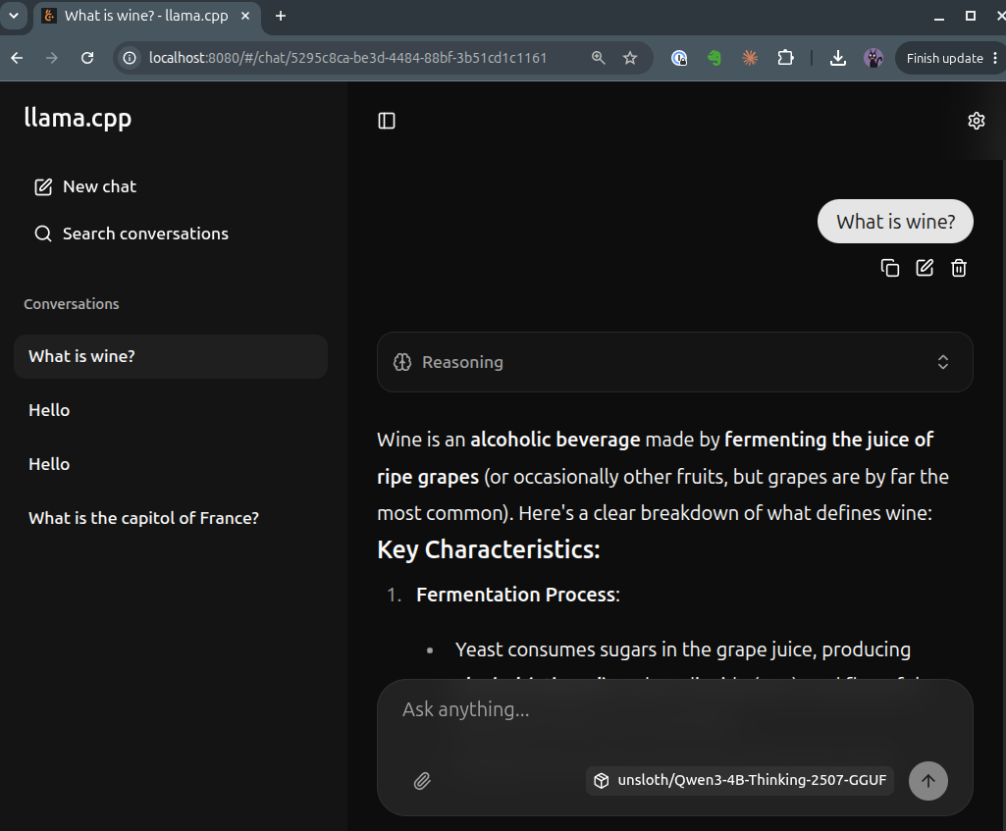
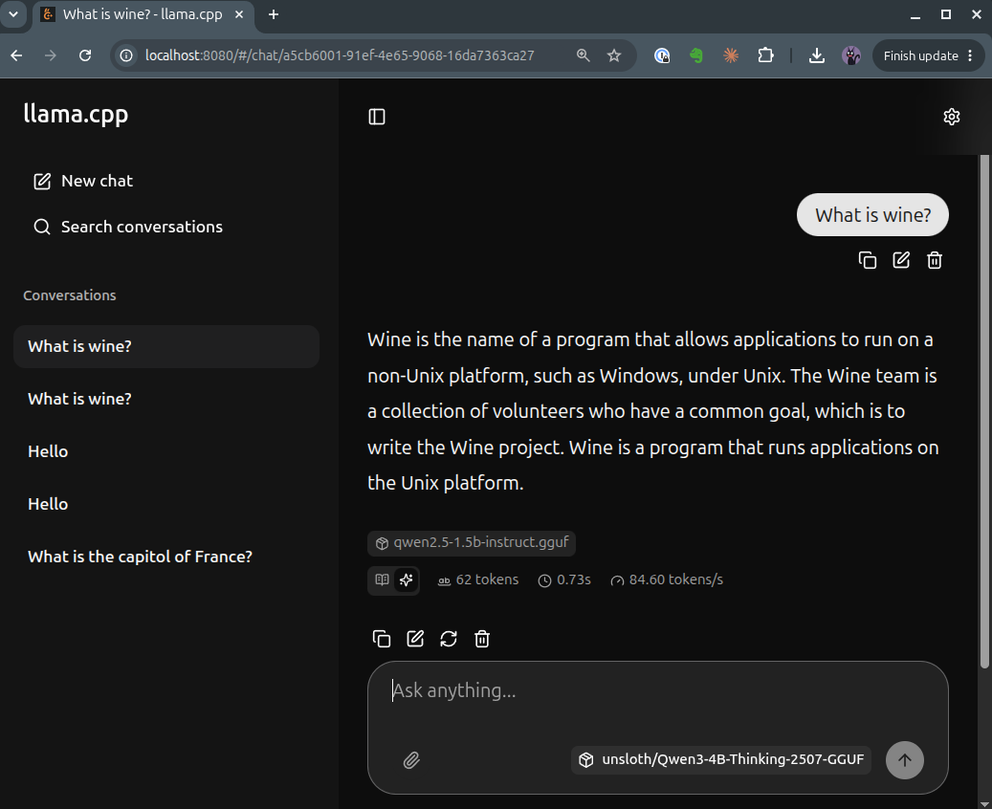
Fine-tuning Example

Slide 38
Customization Trade-offs
Technique | Context Size | Inference Time | Effort
System Prompt | Impacted | Low Impact | Low
RAG | Impacted | Slightly More Impact | Medium
Fine-tuning | Not Impacted | Not Impacted | High

Slide 39
What we’ve learned…
What a model is
Where to find models
How to “run” models
How to enhance inference with relevant data (RAG)
How to fine-tune a model
Lot’s of jargon!

Slide 40
Resources
YouTube:
Alex Ziskind
3blue1brown
MatthewExplains.com

Slide 41

BetterOffline.com

Slide 42
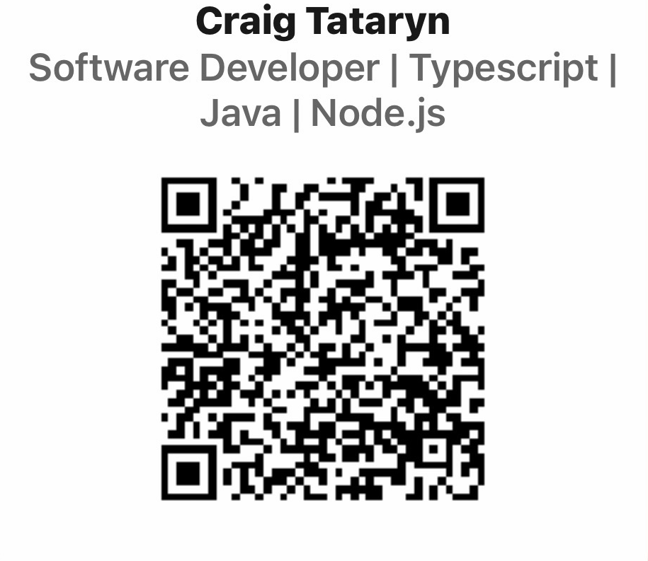
Thank you 🙏
Questions?

